Slide 1

Sequential Models
Recurrent Neural Network ( RNN)
Long Short-Term Memory Cells( LSTM)
Encoder- Decoder Models
Attention Mechanism

Slide 2
Sequential Models
Recurrent Neural Network ( RNN)
Courtesy: Mitesh Kapra NPTEL, analytics vidya,fast.ai, coursera: AndrewNG

Slide 3

“We love working on deep learning”

Slide 4
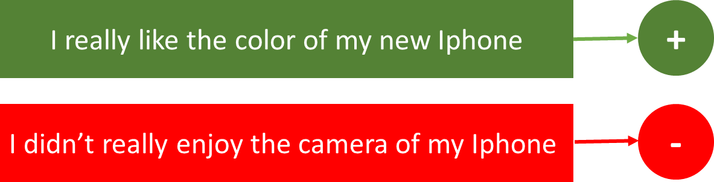
what are kind of tasks ?
Sentiment Classification – This can be a task of simply classifying tweets into positive and negative sentiment. So here the input would be a tweet of varying lengths, while output is of a fixed type and size.
•

Slide 5
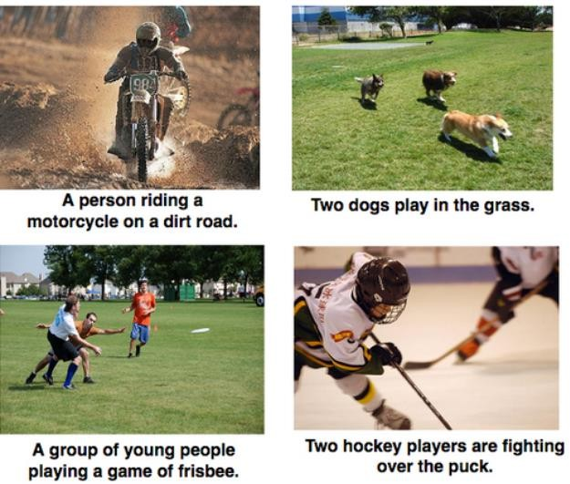
what are kind of tasks ?
Image Captioning – Here, let’s say we have an image for which we need a textual description. So we have a single input – the image, and a series or sequence of words as output. Here the image might be of a fixed size, but the output is a description of varying lengths

Slide 6

what are kind of tasks ?
Language Translation – This basically means that we have some text in a particular language let’s say English, and we wish to translate it in French. Each language has it’s own semantics and would have varying lengths for the same sentence. So here the inputs as well as outputs are of varying lengths.

Slide 7
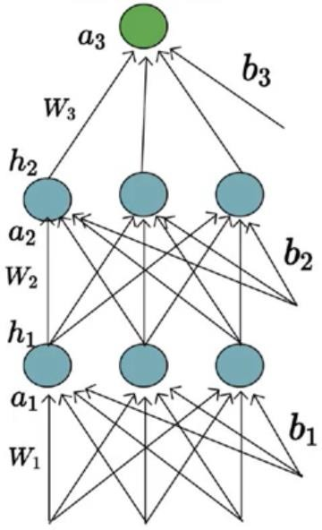
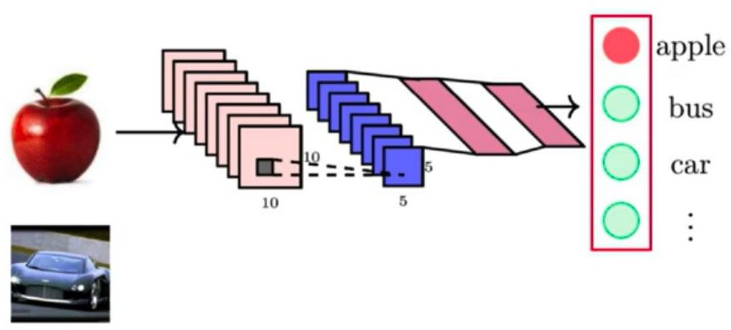
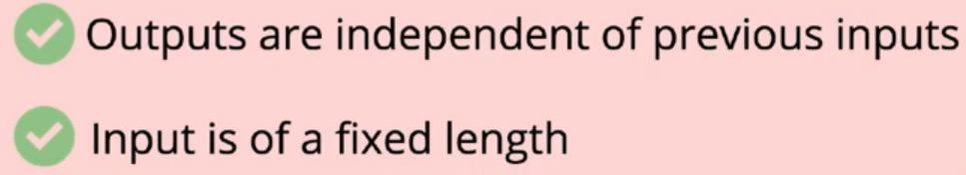
Introduction
x1
x2

Slide 8
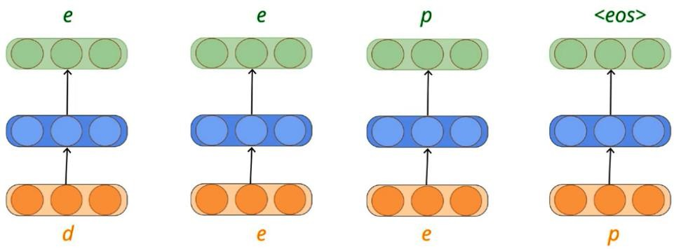
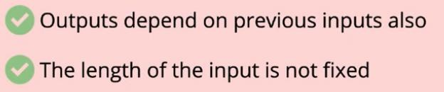
Sequence Learning Problems

Slide 9
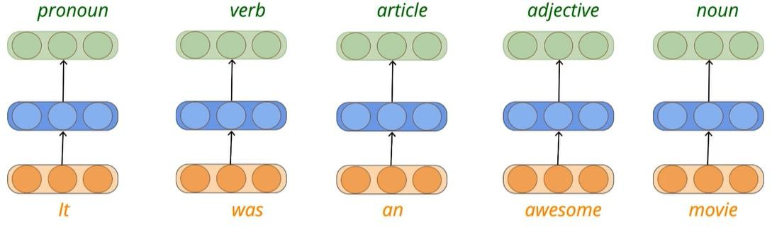
Sequence Learning Problems
Sequence of words
1 hot encoding used to convert input to number
Awesome being an adjective has helped in identifying movie as noun Some words like bank- may be used as noun or verb. So the context matters

Slide 10
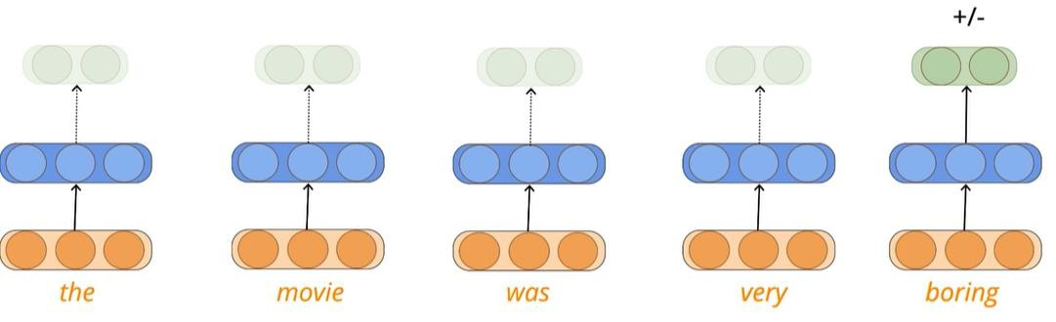
Sequence Learning Problems- Predict the polarity of the sentence
The no: of input and output may not be same. Here the input is a sequence of words and output is single which classifies the sentence polarity- positive or negative.

Slide 11
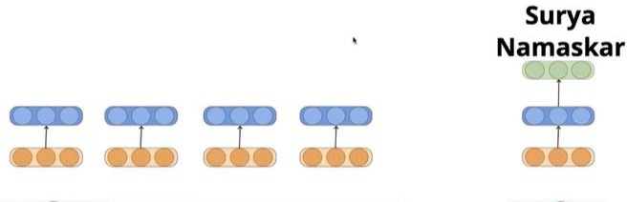
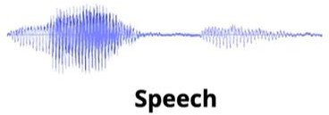
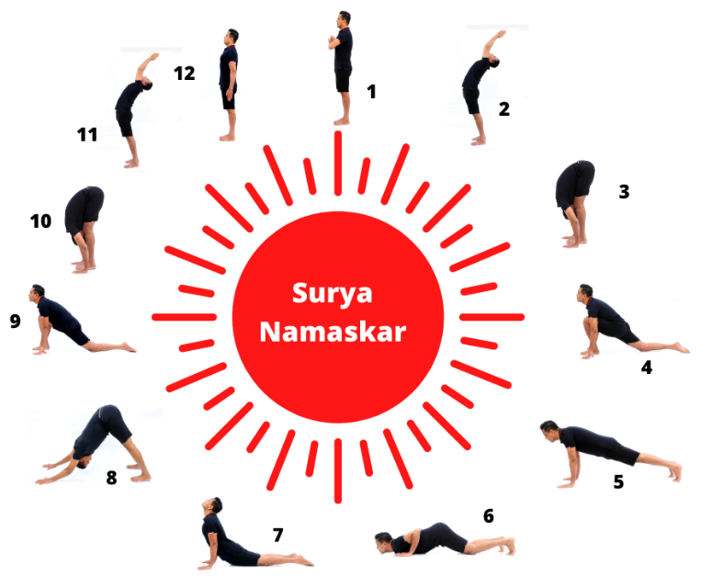
Other sequence learning problems
Speech Processing- another sequence learning problem. Take audio signals as input and classify each of them as phonemes
Yoga Video classification : Each frame in the video correspond to a pose and we want to classify each of the frames into one pose resulting in a sequence of poses
Classify the sequence of yoga posters as one Yoga exercise name - Input is a sequence of frames, and output is a single Yoga exercise name. challenges- Variable no of frames based on speed of action

Slide 12
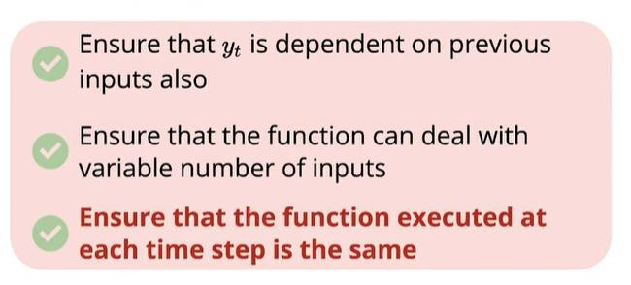

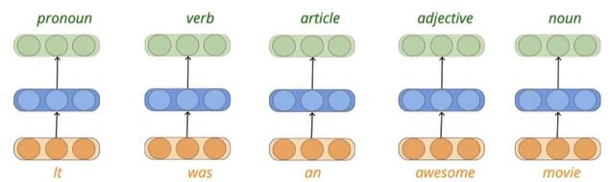
What can be a solution?

Slide 13
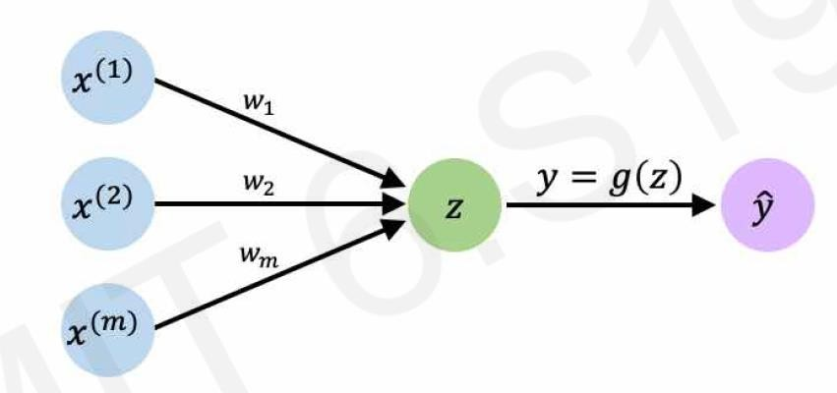
Perceptron Revisited

Slide 14
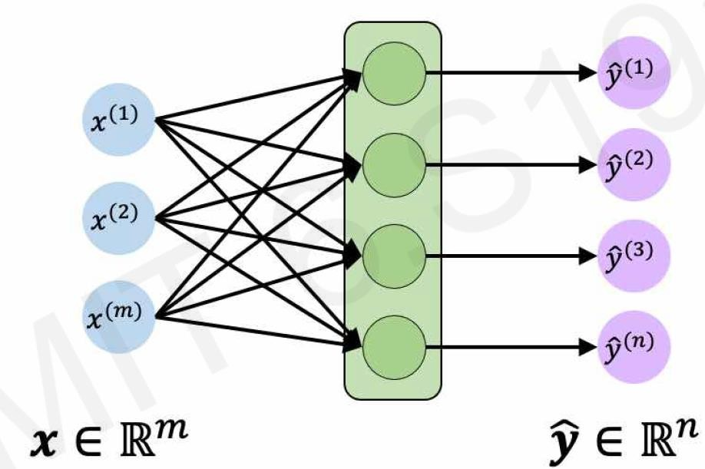
Feed Forward Revisited

Slide 15
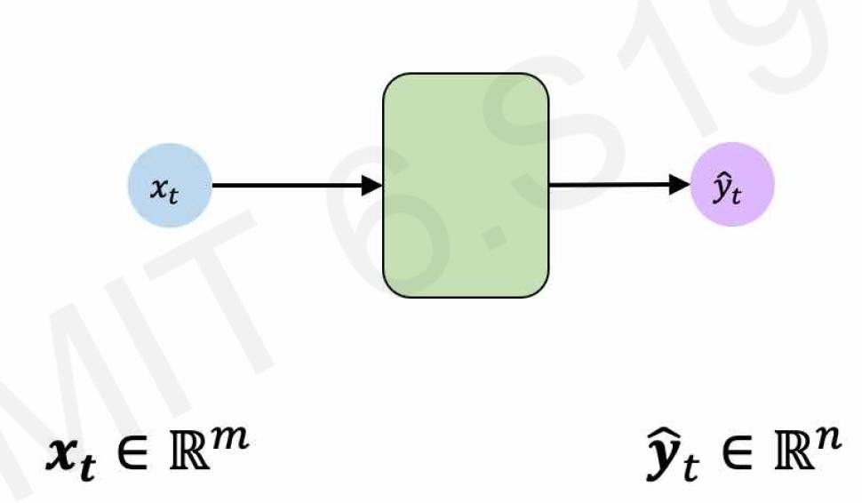
Feed Forward Revisited

Slide 16
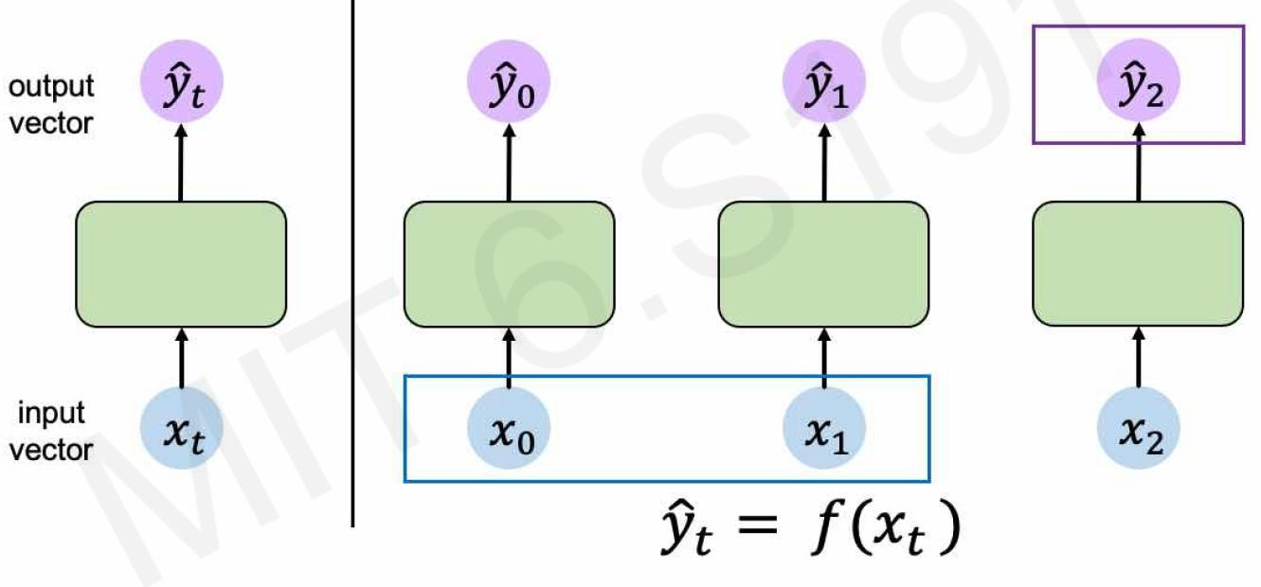
Handling individual Time steps

Slide 17
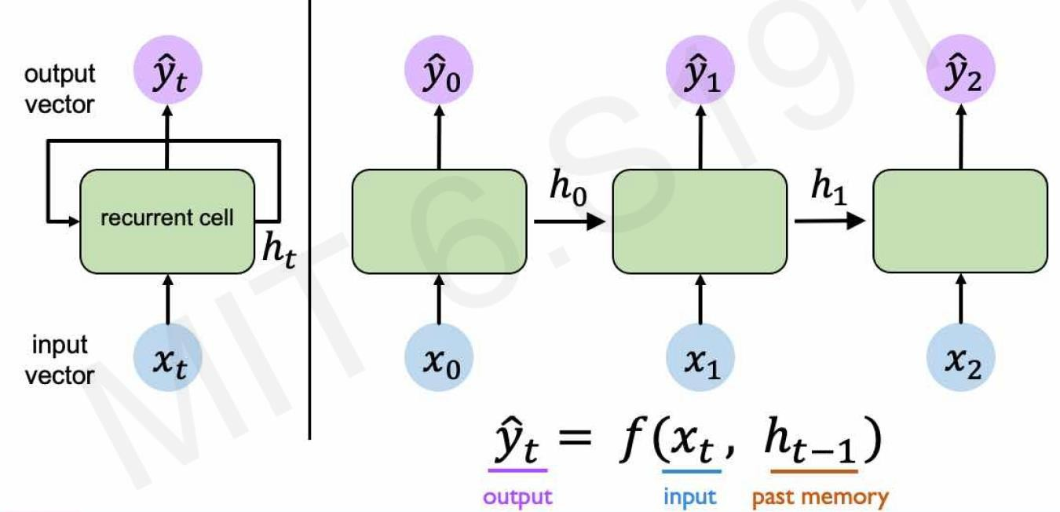
Neurons with Recurrence

Slide 18
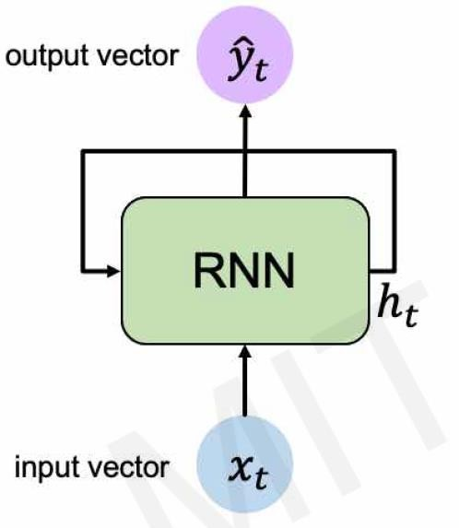
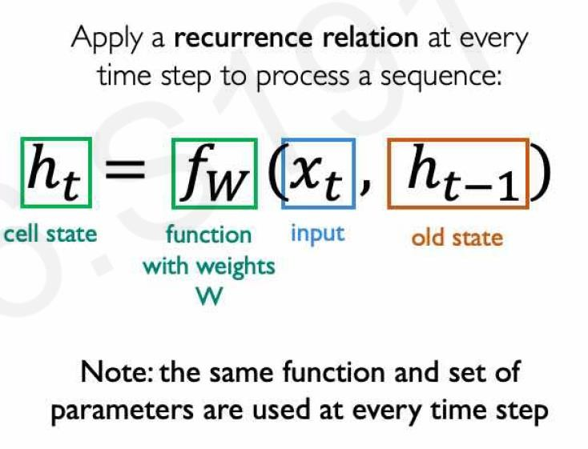
Recurrent Neural Networks
@MIT DeepLearning

Slide 19
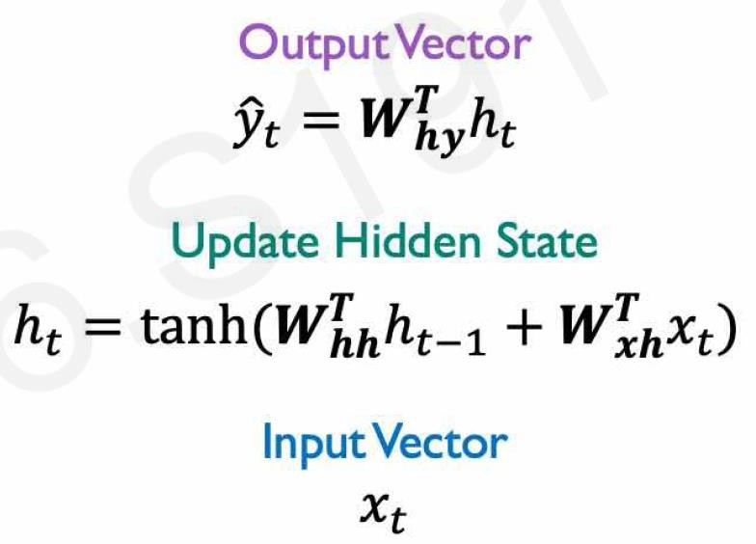
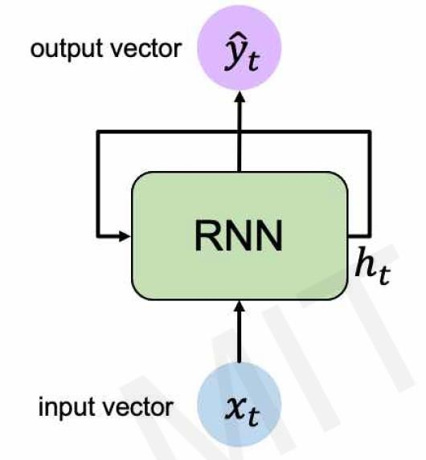
Recurrent Neural Networks

Slide 20
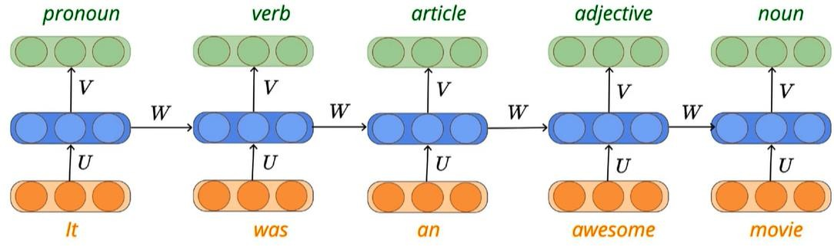
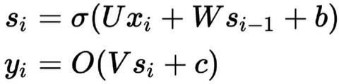

A solution – Recurrent Neural Networks ( RNN)
RNN satisfies all the 3 criterias
s
x

Slide 21
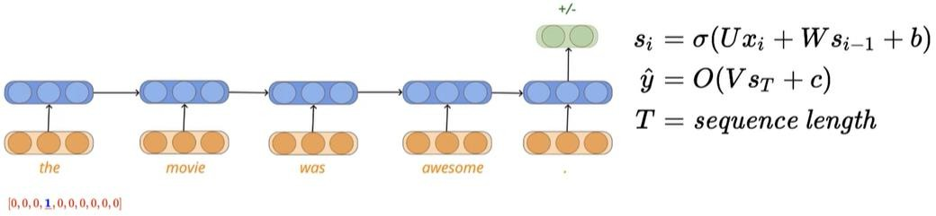
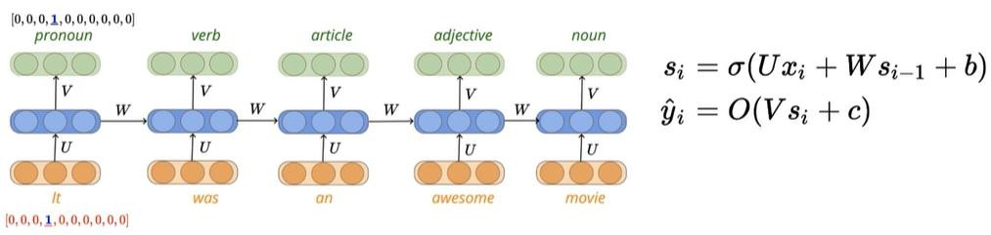
Sequence classification problem ( eg: sentiment analysis-Polarity)
Sequence Labelling problem (eg: parts of speech tagging)

Slide 22
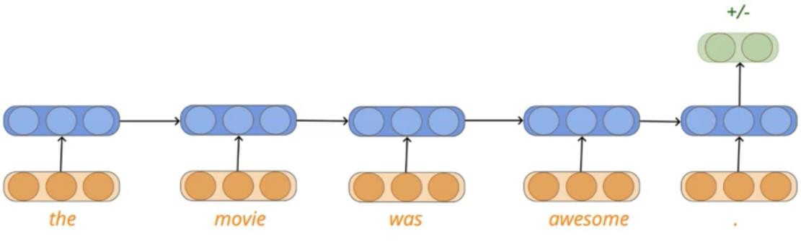
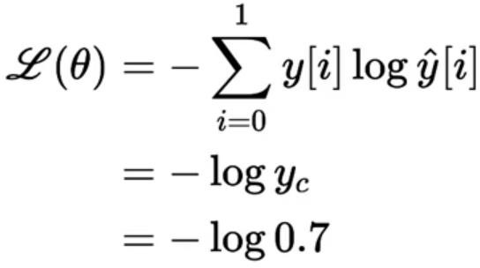
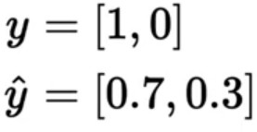
Loss function for sequence classification problem
Only one output at the end Possible output classes [1,0] Y[i]=0 for one hence -log yc

Slide 23
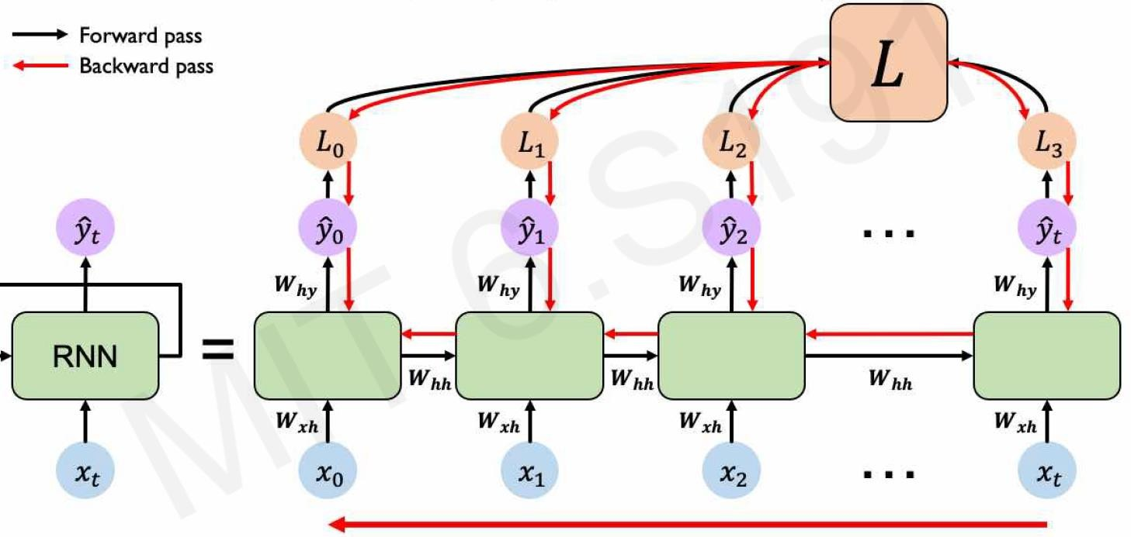
Back propagation through time ( BPTT)
Every time step has an output. Sum up Loss for each time step (T)for each data samples ( m) and average

Slide 24
Back propagation through time ( BPTT)
Every time step has an output. Sum up Loss for each time step (T)for each data samples ( m) and average

Slide 25


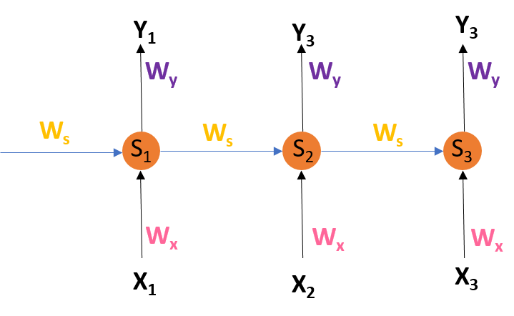
Back propagation through time ( BPTT)
S1, S2, S3 are the hidden states or memory units at time t1, t2, t3 respectively, and Ws is the weight matrix associated with it.
X1, X2, X3 are the inputs at time t1, t2,
t3 respectively, and Wx is the weight matrix
associated with it.
Y1, Y2, Y3 are the outputs at time t1, t2,
t3 respectively, and Wy is the weight matrix
associated with it.
We don’t independently train the system at a specific time “t”. We train it at a specific time “t” as well as
all that has happened before time “t” like t-1, t-2, t-3.

Slide 26





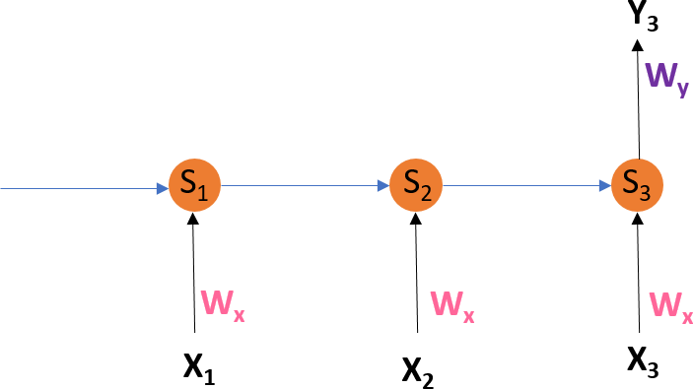









































Back propagation through time ( BPTT)

Slide 27
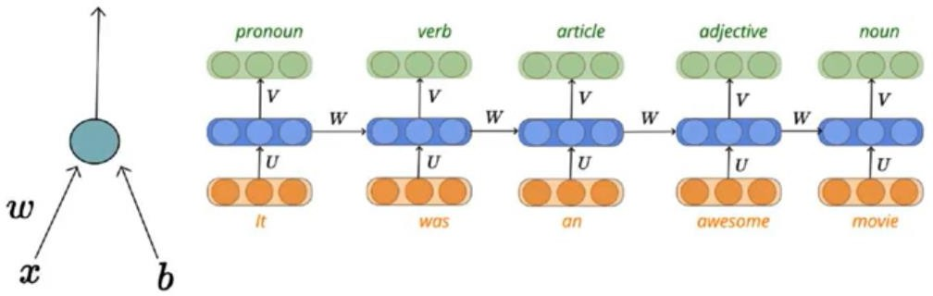
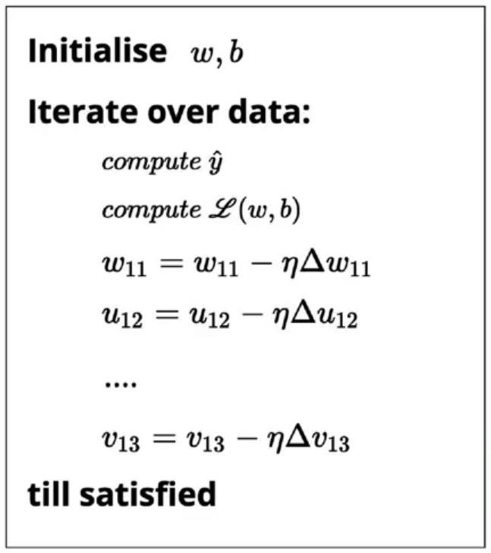
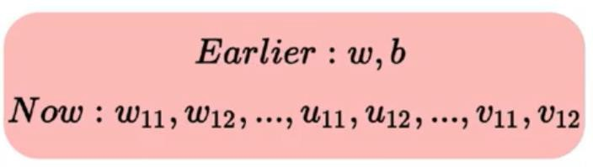
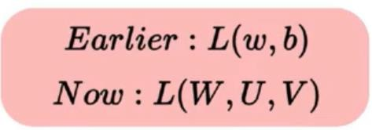
Training Algorithm – Back propagation through time ( BPTT)

Slide 28
Limitations:
This method of Back Propagation through time (BPTT) can be used up to a limited number of time steps like 8 or 10. If we back propagate further, the gradient delta becomes too small. This problem is called the “Vanishing gradient” problem. The problem is that the contribution of information decays geometrically over time. So, if the number of time steps is >10 (Let’s say), that information will effectively be discarded.
Going Beyond RNNs:
One of the famous solutions to this problem is by using what is called Long Short-Term Memory (LSTM for short) cells instead of the traditional RNN cells. But there might arise yet another problem here, called the exploding gradient problem, where the gradient grows uncontrollably large.
Solution: A popular method called gradient clipping can be used where in each time step, we can check if the gradient delta > threshold. If yes, then normalize it.
Go for Transformers!

Slide 29
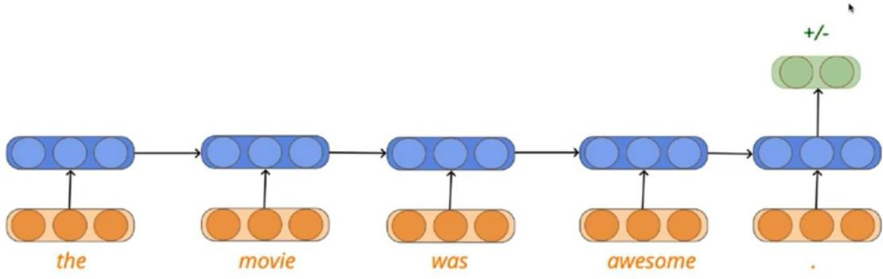
Evaluation- Sequence classification
Predicted y cap | Ground Truth y | Correct/incorrect
1(P) | 1(P) | correct
0(N) | 0(N) | correct
1(P) | 0(N) | incorrect
0(N) | 0(N) | correct
1(P) | 1(P) | correct
0(N) | 1(P) | incorrect
Accuracy =
𝑵𝒐:𝒐𝒇 𝒄𝒐𝒓𝒓𝒆𝒄𝒕𝒍𝒚 𝒄𝒍𝒂𝒔𝒔𝒊𝒇𝒊𝒆𝒅
𝑻𝒐𝒕𝒂𝒍 𝒔𝒂𝒎𝒑𝒍𝒆𝒔

Slide 30
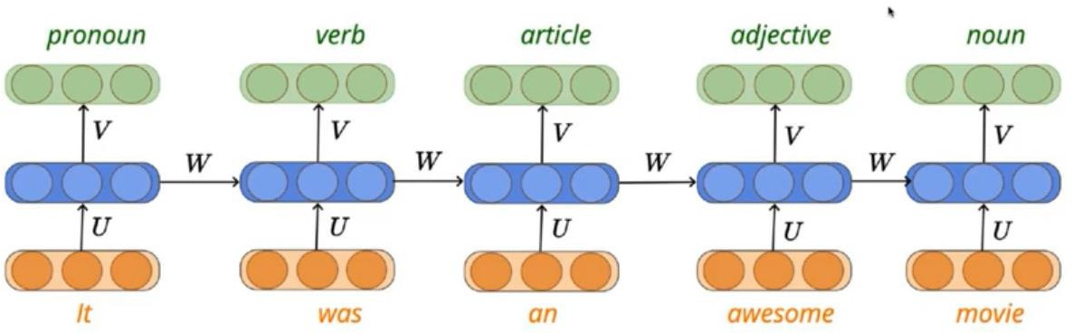
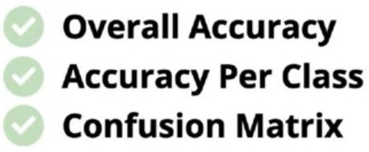
Evaluation Sequence labelling
Overall accuracy /Accuracy per class
Data sample Pronoun verb article adjective noun D1
D2 D3
D4 D5
P | V | Ar | Ad | N
Confusion Matrix
Pronoun verb
article
adjective
noun
Pronoun verb
article
adjective
noun
3 | 2 | 3 | 5 | 6
2 | 7
 |  | 3
 |  |  | 2
 |  |  |  | 1

Slide 31
Sequential Models
Long Short-Term Memory Cells( LSTM)

Slide 32
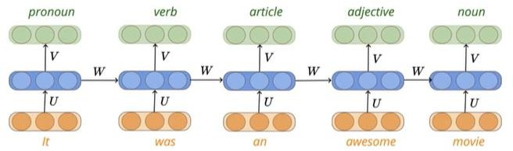
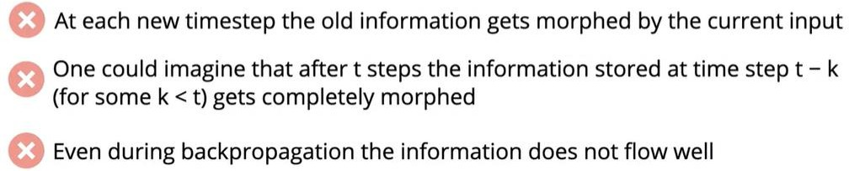
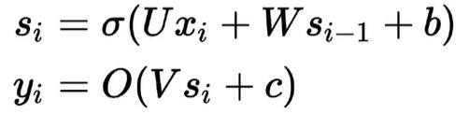
RNN not dealing with longer sequence
(How the state record information when the sequence is very long)
RNN- Recap
RNN: Exploding and vanishing gradient problem occurs!!
Not suitable for longer sequence

Slide 33
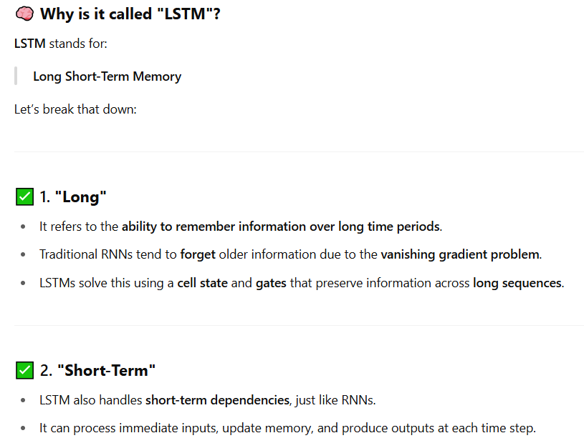
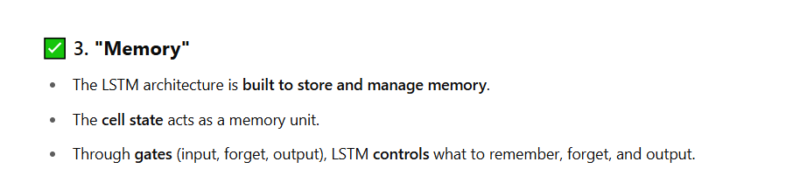
LSTM

Slide 34
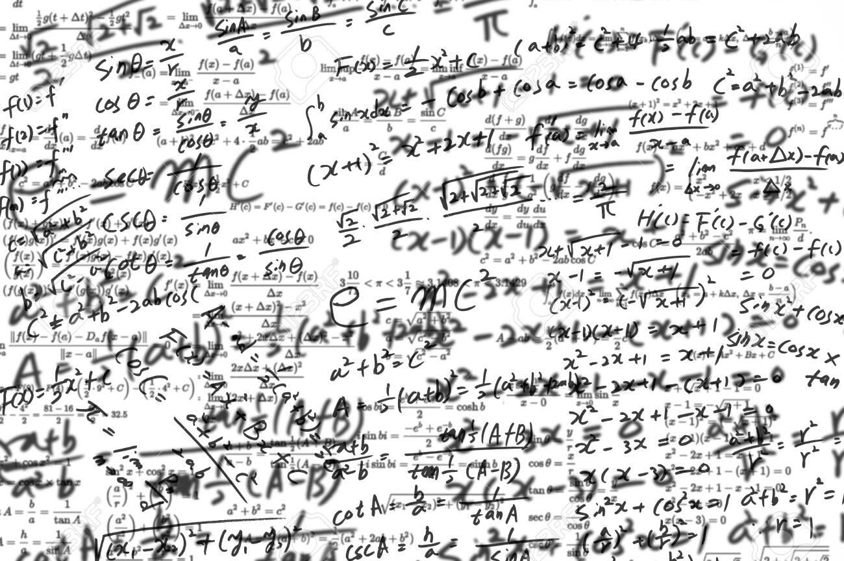
White board Analogy ( over time white board become so messy and u cant make out anything)

Slide 35

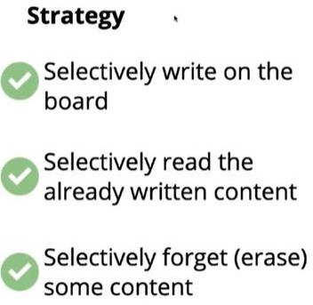
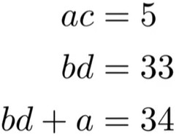
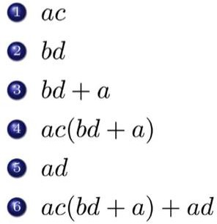
White board Analogy

Slide 36
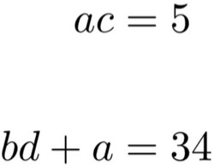
White board Analogy

Slide 37

White board Analogy

Slide 38

White board Analogy

Slide 39

White board Analogy

Slide 40

White board Analogy

Slide 41

White board Analogy

Slide 42



Dealing with longer sequence
( An example where RNN need to selectively read write and forget)

Slide 43
What is LSTM?
LSTM is a type of Recurrent Neural Network (RNN) specifically designed to avoid the vanishing gradient problem and learn long-term dependencies in sequence data.
Introduced by Hochreiter & Schmidhuber (1997), LSTM adds gates and memory cells to standard RNNs, allowing the network to retain relevant information over long periods.
LSTM introduces a memory cell that can maintain information for long periods and three gates (input, forget, output) that control the flow of information.

Slide 44




Long Short-Term Memory Cells – deals with longer
sequences
( How to implement selective read write and Forget

Slide 45

Long Short-Term Memory Cells

Slide 46
Why are they called "Gates"?
In LSTM, each gate uses a sigmoid activation function, which outputs values between 0 and 1. This output acts like a valve or gate, controlling how much information to let through.
A value near 0 = "closed gate" → blocks information
A value near 1 = "open gate" → allows information to pass
So, these are "learned filters" that decide:
What to keep
What to update
What to forget

Slide 47


Slide 48


LSTM
Each green box labeled "A" is an LSTM unit at a time step (e.g., t−1, t, t+1).
The middle unit (highlighted) shows internal operations in detail.
The horizontal arrows represent the flow of information through time — specifically the cell state and hidden state.

Slide 49



Long Short-Term Memory Cells – deals with longer sequences
( How to implement selective read write and Forget)
LSTM
Recap- RNN

Slide 50

Selective write using output gate
In this phrase, there could be a number of options for the empty space. But we know that the current input
of ‘brave’, is an adjective that is used to describe a noun. Thus, whatever word follows, has a strong tendency of being a noun. And thus, Bob could be an apt output.
This job of selecting useful information from the current cell state and showing it out as an output is done via the output gate. Here is its structure
Output gate

Slide 51






Selective write

Slide 52


Selective read using input gate
Now the important information here is that “Bob” knows swimming and that he has served the Navy for four years. This can be added to the cell state, however, the fact that he told all this over the phone is a less important fact and can be ignored. This process of selective read can be done via the input gate.

Slide 53







Selective Read

Slide 54


Selective Forget using Forget Gate
As soon as the first full stop after “person” is encountered, the forget gate realizes that there may be a change of context in the next sentence. As a result of this, the subject of the sentence is forgotten and the place for the subject is vacated. And when we start speaking about “Dan” this position of the
subject is allocated to “Dan”. This process of forgetting the subject is brought about by the forget gate.
Forget gate

Slide 55




Some LSTMs stop after selective read but the actual version LSTM has forget gate also
Selective Forget
ft is called forget gate

Slide 56




Summary-LSTM
LSTM
RNN recap

Slide 57
Gated Recurrent Unit ( GRU)

Slide 58


LSTM variants

Slide 59




Gated Recurrent Units ( GRU)
Recap LSTM
GRUs combine the forget + input gate of LSTMs into one update gate, making them faster and simpler
Candidate State ${\tilde{s}}_{t}$
It has two gates instead of three:
Update Gate (iₜ)
Reset Gate (oₜ)

Slide 60
Encoder- Decoder Models

Slide 61

Encoder- Decoder Architecture
The encoder-decoder architecture can handle inputs and outputs that are both variable-length sequences, thus is suitable for sequence transduction problems such as machine translation. The encoder takes a variable-length sequence as the input and transforms it into a state with a fixed shape.
Machine translation is a major problem domain for sequence transduction models, whose input and output are both variable-length sequences. To handle this type of inputs and outputs, we can design an architecture with two major components. The first component is an encoder: it takes a variable-length sequence as the input and transforms it into a state with a fixed shape. The second component is a decoder: it maps the encoded state of a fixed shape to a variable-length sequence. This is called an encoder-decoder architecture,

Slide 62

Encoder- decoder
Encoder reads the input sequence and summarizes the information in something called the internal state vectors or context vector

Slide 63


Recap – RNN ( Autofill words)

Slide 64

Recap - RNN

Slide 65



Recap - RNN

Slide 66







Slide 67



Encoder – Decoder for Image Captioning
Image Captioning Problem

Slide 68


Encoder – Decoder for Image Captioning
During training phase teacher forcing technique is used

Slide 69


Encoder – Decoder for Image Captioning
𝑆₁ = 𝜎 𝑊_{𝑆0} + 𝑈_{x1} + 𝑏
S0 computed from CNN, x1 <GO>
𝑆₂ = 𝜎 𝑊_{𝑆1} + 𝑈_{x2} + 𝑏

Slide 70



Encoder – Decoder for Image Captioning
𝑆₂ = 𝜎
𝑊_{𝑆1} + 𝑈 _{𝑥 1𝑠1} + 𝑏
Concatenate x1 and S1
Recap

Slide 71




Slide 72


Encoder – Decoder for Machine Translation( seq2seq)

Slide 73


Encoder – Decoder for Machine Translation

Slide 74


Encoder – Decoder for Machine Transliteration

Slide 75


Encoder – Decoder for Machine Transliteration

Slide 76
Attention Mechanism in Deep Learning

Slide 77






What is Attention?
In psychology
Attention is the cognitive process of selectively concentrating on one or a few things while ignoring others

Slide 78


Examples of attention modeling in sentiment classification

Slide 79

Attention Mechanism in Deep Learning
The introduction of the Attention Mechanism in deep learning has improved the success of various models in recent years,
Continues to be an omnipresent component in state-of-the-art models.
Therefore, it is vital that we pay Attention to Attention and how it goes about achieving its effectiveness.

Slide 80
Sequential Models : Evolution
RNN
LSTM
GRU
Encoder decoder
Attention Models
Graph Attention Networks (GAT)
social networks, citation networks, protein-protein interactions,
Memory Network Architectures
Question Answering (QA)
and chat bots
Attention based Encoder Decoder Models
Transformers-
Self Attention
Video processing/NLP

Slide 81
Attention Mechanism in Encoder Decoder Models

Slide 82

Challenges of traditional encoder-decoder framework.
The encoder has to compress all the input
information into a single fixed length vector
One vector to compress long and detailed input sequences may lead to loss of information
it is unable to model alignment between input and output sequences,
Decoder lacks any mechanism to selectively focus on relevant input tokens while generating each output token.

Slide 83

Dzmitry Bahdanau Jacobs University
Bremen, Germany
KyungHyun Cho Universit´e de Montr´eal Yoshua Bengio
ICLR 2015

Slide 84

Attention mechanism in Encoder Decoder

Slide 85

Attention Mechanism
Encoding
Computing Attention weights
Creating context vector
Decoding / Translation

Slide 86



Attention Mechanism

Slide 87


Machine Translation with Attention Mechanism

Slide 88



Machine Translation with Attention Mechanism

Slide 89




Machine Translation with Attention Mechanism

Slide 90

Machine Translation with Attention Mechanism

Slide 91


Machine Translation with Attention Mechanism

